Slide 1

Session 12
Events, Delegates and Collections

Slide 2

Objectives
Explain delegates
Explain events
Define and describe collections

Slide 3
Delegates
Following are the features of delegates:
In the .NET Framework, a delegate points to one or more methods. Once you instantiate the delegate, the corresponding methods invoke.
Delegates are objects that contain references to methods that need to be invoked instead of containing the actual method names.
Using delegates, you can call any method, which is identified only at run-time.
A delegate is like having a general method name that points to various methods at different times and invokes the required method at run-time.
In C#, invoking a delegate will execute the referenced method at run-time.
To associate a delegate with a particular method, the method must have the same return type and parameter type as that of the delegate.

Slide 4
Delegates in C#
Consider two methods, Add() and Subtract(). The method Add() takes two parameters of type integer and returns their sum as an integer value. Similarly, the method Subtract() takes two parameters of type integer and returns their difference as an integer value.
Since both methods have the same parameter and return types, a delegate, Calculation, can be created to be used to refer to Add() or Subtract(). However, when the delegate is called while pointing to Add(), the parameters will be added. Similarly, if the delegate is called while pointing to Subtract(), the parameters will be subtracted.
Following are the features of delegates in C# that distinguish them from normal methods:
Methods can be passed as parameters to a delegate. In addition, a delegate can accept a block of code as a parameter. Such blocks are referred to as anonymous methods because they have no method name.
A delegate can invoke multiple methods simultaneously. This is known as multicasting.
A delegate can encapsulate static methods.
Delegates ensure type-safety as the return and parameter types of the delegate are the same as that of the referenced method. This ensures secured reliable data to be passed to the invoked method.

Slide 5
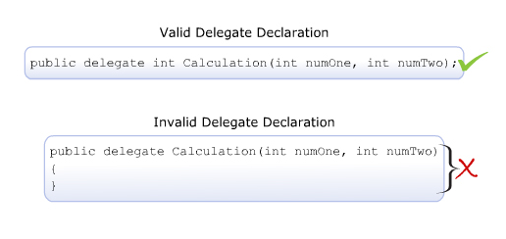
Declaring Delegates
Delegates in C# are declared using the delegate keyword followed by the return type and the parameters of the referenced method.
Declaring a delegate is quite similar to declaring a method except that there is no implementation. Thus, the declaration statement must end with a semi-colon.
The following figure displays an example of declaring delegates:
The following syntax is used to declare a delegate:
where,
access_modifier: Specifies the scope of access for the delegate. If declared outside the class, the scope will always be public.
return_type: Specifies the data type of the value that is returned by the method.
DelegateName: Specifies the name of the delegate.
list_of_parameters: Specifies the data types and names of parameters to be passed to the method.
The following code declares the delegate Calculation with the return type and the parameter types as integer:
Syntax
<access_modifier> delegate <return_type> DelegateName([list_of_parameters]);
Snippet
public delegate int Calculation(int numOne, int numTwo);

Slide 6
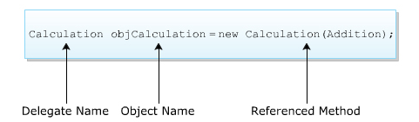
Instantiating Delegates 1-2
The next step after declaring the delegate is to instantiate the delegate and associate it with the required method by creating an object of the delegate.
Like all other objects, an object of a delegate is created using the new keyword.
This object takes the name of the method as a parameter and this method has a signature similar to that of the delegate.
The created object is used to invoke the associated method at run-time.
The following figure displays an example of instantiating delegates:
The following syntax is used to instantiate a delegate:
where,
DelegateName: Specifies the name of the delegate.
objName: Specifies the name of the delegate object.
MethodName: Specifies the name of the method to be referenced by the delegate object.
Syntax
<DelegateName><objName> = new <DelegateName>(<MethodName>);

Slide 7
Instantiating Delegates 2-2
The following code declares a delegate Calculation outside the class Mathematics and instantiates it in the class:
In the code:
The delegate called Calculation is declared outside the class Mathematics.
In the Main() method, an object of the delegate is created that takes the Addition() method as the parameter. The parameter type of the method and that of the delegate is the same, which is type int.
5 + 23= 28
Snippet
public delegate int Calculation (int numOne, int numTwo);
class Mathematics
{
static int Addition(int numOne, int numTwo)
{
return (numOne + numTwo);
}
static int Subtraction(int numOne, int numTwo)
{
return (numOne - numTwo);
}
static void Main(string[] args)
{
int valOne = 5;
int valTwo = 23;
Calculation objCalculation = new Calculation(Addition);
Console.WriteLine (valOne + “ + “ + valTwo + “ = “ +
objCalculation (valOne, valTwo));
}
}
Output

Slide 8
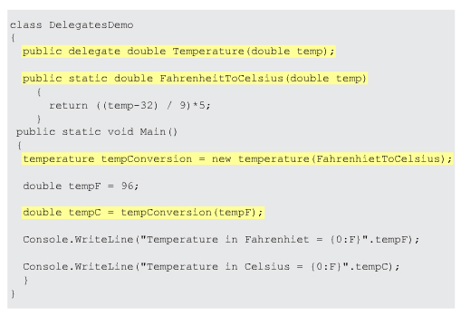
Using Delegates 1-2
A delegate can be declared either before creating the class (having the method to be referenced) or can be defined within the class.
The following are the four steps to implement delegates in C#:
Each of these step is demonstrated with an example shown in the following figure:
Declare a delegate.
Create the method to be referenced by the delegate.
Instantiate the delegate.
Call the method using the object of the delegate.

Slide 9
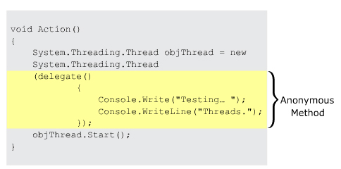
Using Delegates 2-2
An anonymous method is an inline block of code that can be passed as a delegate parameter that helps to avoid creating named methods.
The following figure displays an example of using anonymous methods:

Slide 10
Delegate-Event Model
The delegate-event model is a programming model that enables a user to interact with a computer and computer-controlled devices using graphical user interfaces. This model consists of:
An event source, which is the console window in case of console-based applications.
Listeners that receive the events from the event source.
A medium that gives the necessary protocol by which every event is communicated.
In this model, every listener must implement a medium for the event that it wants to listen to by using the medium, every time the source generates an event, the event is notified to the registered listeners.
Consider a guest ringing a doorbell at the doorstep of a home. The host at home listens to the bell and responds to the ringing action by opening the door.
Here, the ringing of the bell is an event that resulted in the reaction of opening the door. Similarly, in C#, an event is a generated action that triggers its reaction.
For example, pressing Ctrl+Break on a console-based server window is an event that will cause the server to terminate.
This event results in storing the information in the database, which is the triggered reaction. Here, the listener is the object that invokes the required method to store the information in the database.
Delegates can be used to handle events as they take methods that need to be invoked when events occur which are referred to as the event handlers.
Example

Slide 11
Multiple Delegates 1-2
In C#, a user can invoke multiple delegates within a single program. Depending on the delegate name or the type of parameters passed to the delegate, the appropriate delegate is invoked.
The following code demonstrates the use of multiple delegates by creating two delegates CalculateArea and CalculateVolume that have their return types and parameter types as double:
Snippet
using System;
public delegate double CalculateArea(double val);
public delegate double CalculateVolume(double val);
class Cube
{
static double Area(double val)
{
return 6 * (val * val);
}
static double Volume(double val)
{
return (val * val);
}
static void Main(string[] args)
{
CalculateArea objCalculateArea = new CalculateArea(Area);
CalculateVolume objCalculateVolume = new
CalculateVolume(Volume);
Console.WriteLine ("Surface Area of Cube: " +
objCalculateArea(200.32));
Console.WriteLine("Volume of Cube: " +
objCalculateVolume(20.56));
}
}

Slide 12
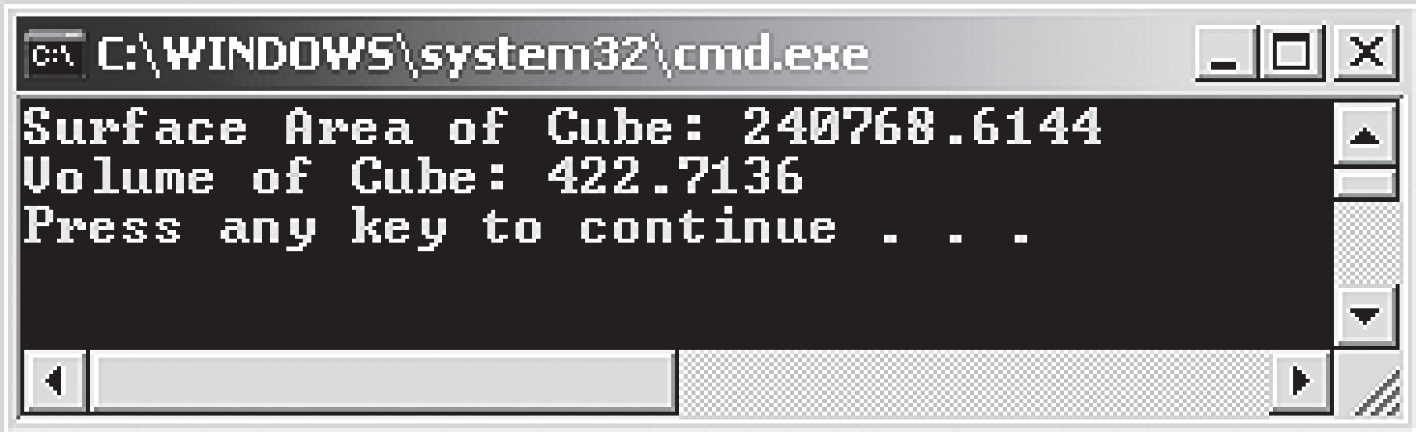
Multiple Delegates 2-2
In the code:
When the delegates CalculateArea and CalculateVolume are instantiated in the Main() method, the references of the methods Area and Volume are passed as parameters to the delegates CalculateArea and CalculateVolume respectively.
The values are passed to the instances of appropriate delegates, which in turn invoke the respective methods.
The following figure shows the use of multiple delegates:

Slide 13

Multicast Delegates 1-3
A single delegate can encapsulate the references of multiple methods at a time to hold a number of method references.
Such delegates are termed as ‘Multicast Delegates’ that maintain a list of methods (invocation list) that will be automatically called when the delegate is invoked.
Multicast delegates in C# are sub-types of the System.MulticastDelegate class. Multicast delegates are defined in the same way as simple delegates, however, the return type of multicast delegates can only be void.
If any other return type is specified, a run-time exception will occur because if the delegate returns a value, the return value of the last method in the invocation list of the delegate will become the return type of the delegate resulting in inappropriate results. Hence, the return type is always void.
To add methods into the invocation list of a multicast delegate, the user can use the ‘+’ or the ‘+=’ assignment operator. Similarly, to remove a method from the delegate’s invocation list, the user can use the ‘-‘ or the ‘-=’ operator. When a multicast delegate is invoked, all the methods in the list are invoked sequentially in the same order in which they have been added.

Slide 14
Multicast Delegates 2-3
The following code creates a multicast delegate Maths. This delegate encapsulates the reference to the methods Addition, Subtraction, Multiplication, and Division:
Snippet
using System;
public delegate void Maths (int valOne, int valTwo);
class MathsDemo
{
static void Addition(int valOne, int valTwo)
{
int result = valOne + valTwo;
Console.WriteLine("Addition: " + valOne + " + " +
valTwo + "= " + result);
}
static void Subtraction(int valOne, int valTwo)
{
int result = valOne - valTwo;
Console.WriteLine("Subtraction: " + valOne + " - " +
valTwo + "= " + result);
}
static void Multiplication(int valOne, int valTwo)
{
int result = valOne * valTwo;
Console.WriteLine("Multiplication: " + valOne + " * "
+ valTwo + "= " + result);
}

Slide 15
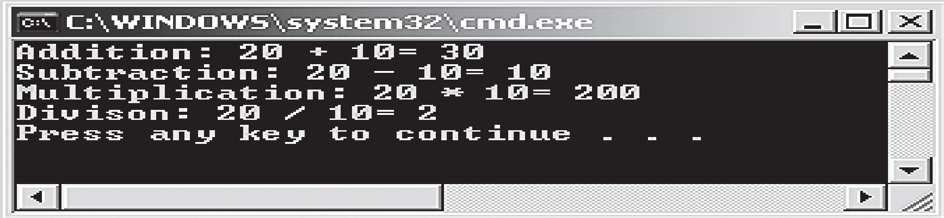
Multicast Delegates 3-3
In the code:
The delegate Maths is instantiated in the Main() method. Once the object is created, methods are added to it using the ‘+=’ assignment operator, which makes the delegate a multicast delegate.
The following figure shows the creation of a multicast delegate:
static void Division(int valOne, int valTwo)
{
int result = valOne / valTwo;
Console.WriteLine("Division: " + valOne + " / " +
valTwo + "= " + result);
}
static void Main(string[] args)
{
Maths objMaths = new Maths(Addition);
objMaths += new Maths(Subtraction);
objMaths += new Maths(Multiplication);
objMaths += new Maths(Division);
if (objMaths != null)
{
objMaths(20, 10);
}
}
}

Slide 16
System.Delegate Class 1-5
The Delegate class of the System namespace is a built-in class defined to create delegates in C#.
All delegates in C# implicitly inherit from the Delegate class. This is because the delegate keyword indicates to the compiler that the defined delegate in a program is to be derived from the Delegate class. The Delegate class provides various constructors, methods, and properties to create, manipulate, and retrieve delegates defined in a program.
The following table lists the constructors defined in the Delegate class:
The following table lists the properties defined in the Delegate class:
Constructor | Description
Delegate(object, string) | Calls a method referenced by the object of the class given as the parameter
Delegate(type, string) | Calls a static method of the class given as the parameter
Property | Description
Method | Retrieves the referenced method
Target | Retrieves the object of the class in which the delegate invokes the referenced method

Slide 17
System.Delegate Class 2-5
The following table lists some of the methods defined in the Delegate class:
The following code demonstrates the use of some of the properties and methods of the built-in Delegate class:
Method | Description
Clone | Makes a copy of the current delegate
Combine | Merges the invocation lists of the multicast delegates
CreateDelegate | Declares and initializes a delegate
DynamicInvoke | Calls the referenced method at run-time
GetInvocationList | Retrieves the invocation list of the current delegate
Snippet
using System;
public delegate void Messenger(int value);
class CompositeDelegates
{
static void EvenNumbers(int value)
{
Console.Write("Even Numbers: ");
for (int i = 2; i <= value; i+=2)
{
Console.Write(i + " ");
}
}
void OddNumbers(int value)
{

Slide 18
System.Delegate Class 3-5
Console.WriteLine();
Console.Write("Odd Numbers: ");
for (int i = 1; i <= value; i += 2)
{
Console.Write (i + " ");
}
}
static void Start(int number)
{
CompositeDelegates objComposite = new CompositeDelegates();
Messenger objDisplayOne = new Messenger(EvenNumbers);
Messenger objDisplayTwo = new Messenger
(objComposite.OddNumbers);
Messenger objDisplayComposite =
(Messenger)Delegate.Combine
(objDisplayOne, objDisplayTwo);
objDisplayComposite(number);
Console.WriteLine();
Object obj = objDisplayComposite.Method.ToString();
if (obj != null)
{
Console.WriteLine ("The delegate invokes an instance
method: " + obj);
}
else
{
Console.WriteLine ("The delegate invokes only
static methods");
}

Slide 19
System.Delegate Class 4-5
In the code:
The delegate Messenger is instantiated in the Start() method.
An instance of the delegate, objDisplayOne, takes the static method, EvenNumbers(), as a parameter, and another instance of the delegate, objDisplayTwo, takes the non-static method, OddNumbers(), as a parameter by using the instance of the class.
The Combine() method merges the delegates provided in the list within the parentheses.
}
static void Main(string[] args)
{
int value = 0;
Console.WriteLine("Enter the values till which you want
to display even and odd numbers");
try
{
value = Convert.ToInt32(Console.ReadLine());
}
catch (FormatException objFormat)
{
Console.WriteLine("Error: " + objFormat);
}
Start(value);
}
}

Slide 20
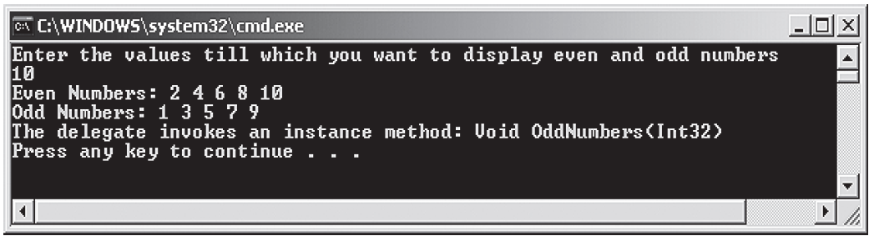
System.Delegate Class 5-5
The Method property checks whether the program contains instance methods or static methods. If the program contains only static methods, then the Method property returns a null value.
The Main() method allows the user to enter a value. The Start() method is called by passing this value as a parameter. This value is again passed to the instance of the class CompositeDelegates as a parameter, which in turn invokes both the delegates.
The code displays even and odd numbers within the specified range by invoking the appropriate methods.
The following figure shows the use of some of the properties and methods of the Delegate class:

Slide 21
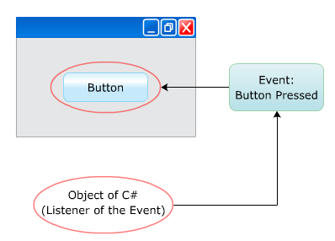
Events
Consider a group of people at a party playing Bingo. When a number is called, the participants check if the number is on their cards whereas the non-participants go about their business, enjoying other activities.
If this situation is analyzed from a programmer’s perspective, the calling of the number corresponds to the occurrence of an event.
The notification about the event is given by the announcer.
Here, the people playing the game are paying attention (subscribing) to what the announcer (the source of the event) has to say (notify).
Similarly, in C#, events allow an object (source of the event) to notify other objects (subscribers) about the event (a change having occurred).
The following figure depicts the concept of events:

Slide 22
Features
An event is a user-generated or system-generated action that enables the required objects to notify other objects or classes to handle the event. Events in C# have the following features:
Events can be used to perform customized actions that are not already supported by C#.
Events are widely used in creating GUI based applications, where events such as, selecting an item from a list and closing a window are tracked.
They can be declared in classes and interfaces.
They can be declared as abstract or sealed.
They can be declared as virtual.
They are implemented using delegates.

Slide 23
Creating and Using Events
Following are the four steps for implementing events in C#:
Events use delegates to call methods in objects that have subscribed to the event.
When an event containing a number of subscribers is raised, many delegates will be invoked.
Define a public delegate for the event.
Create the event using the delegate.
Subscribe to listen and handle the event.
Raise the event.

Slide 24
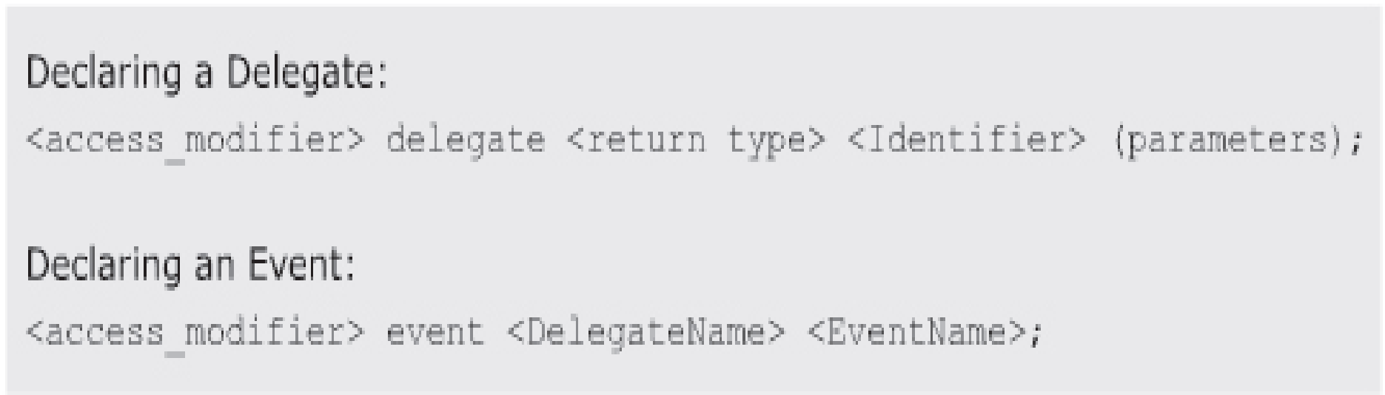
Declaring Events 1-2
An event declaration consists of two steps, creating a delegate and creating the event. A delegate is declared using the delegate keyword.
The delegate passes the parameters of the appropriate method to be invoked when an event is generated.
This method is known as the event handler.
The event is then declared using the event keyword followed by the name of the delegate and the name of the event.
This declaration associates the event with the delegate.
The following figure displays the syntax for declaring delegates and events:
An object can subscribe to an event only if the event exists. To subscribe to the event, the object adds a delegate that calls a method when the event is raised.
This is done by associating the event handler to the created event, using the += addition assignment operator which is known as subscribing to an event.

Slide 25
Declaring Events 2-2
To unsubscribe from an event, use the -= subtraction assignment operator.
The following syntax is used to create a method in the receiver class:
where,
objectName: Is the object of the class in which the event handler is defined.
The following code associates the event handler to the declared event:
In the code:
The delegate called PrintDetails() is declared without any parameters. In the class TestEvent, the event Print is created that is associated with the delegate. In the Main() method, object of the class TestEvent is used to subscribe the event handler called Show() to the event Print.
Syntax
<access_modifier> <return_type> <MethodName> (parameters);
using System;
public delegate void PrintDetails();
class TestEvent
{
event PrintDetails Print;
void Show()
{
Console.WriteLine(“This program illustrate how to subscribe objects
to an event”);
Console.WriteLine(“This method will not execute since the event has
not been raised”);
}
static void Main(string[] args)
{
TestEvent objTestEvent = new TestEvent();
objTestEvent.Print += new PrintDetails(objEvents.Show);
}
}

Slide 26
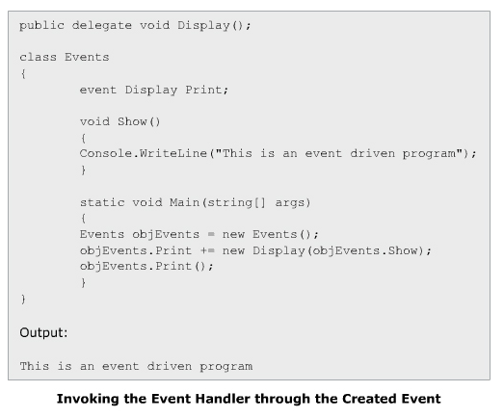
Raising Events 1-2
An event is raised to notify all the objects that have subscribed to the event. Events are either raised by the user or the system.
Once an event is generated, all the associated event handlers are executed. The delegate calls all the handlers that have been added to the event.
However, before raising an event, it is important for you to create handlers and thus, make sure that the event is associated to the appropriate event handlers.
If the event is not associated to any event handler, the declared event is considered to be null.
The following figure displays the raising events:

Slide 27
Raising Events 2-2
The following code can be used to check a particular condition before raising the event:
In the code:
If the checked condition is satisfied, the event eventMe is raised.
The syntax for raising an event is similar to the syntax for calling a method. When eventMe is raised, it will invoke all the delegates of the objects that have subscribed to it. If no objects have subscribed to the event and the event has been raised, an exception is thrown.
Snippet
if(condition)
{
eventMe();
}

Slide 28
Events and Inheritance 1-2
Events in C# can only be invoked in the class in which they are declared and defined. Therefore, events cannot be directly invoked by the derived classes. However, events can be invoked indirectly in C# by creating a protected method in the base class that will, in turn, invoke the event defined in the base class. The following code illustrates how an event can be indirectly invoked:
Snippet
using System;
public delegate void Display(string msg);
public class Parent
{
event Display Print;
protected void InvokeMethod()
{
Print += new Display(PrintMessage);
Check();
}
void Check()
{
if (Print != null)
{
PrintMessage("Welcome to C#");
}
}
void PrintMessage(string msg)
{
Console.WriteLine(msg);
}
}
class Child : Parent
{
static void Main(string[] args)
{
Child objChild = new Child();
objChild.InvokeMethod();
}
}

Slide 29
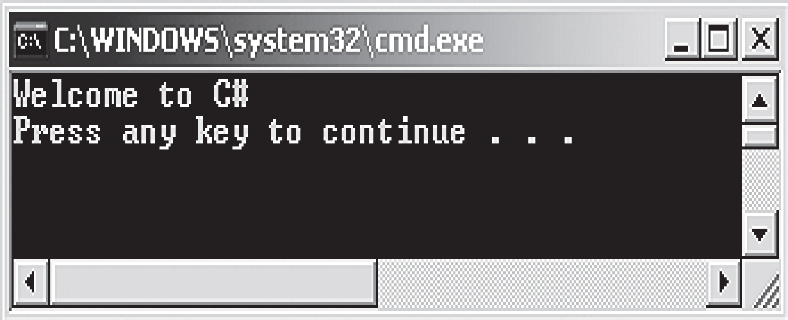
Events and Inheritance 2-2
In the code:
The class Child is inherited from the class Parent. An event named Print is created in the class Parent and is associated with the delegate Display. The protected method InvokeMethod() associates the event with the delegate and passes the method PrintMessage() as a parameter to the delegate. The Check() method checks whether any method is subscribing to the event. Since the PrintMessage() method is subscribing to the Print event, this method is called. The Main() method creates an instance of the derived class Child. This instance invokes the InvokeMethod() method, which allows the derived class Child access to the event Print declared in the base class Parent.
The following figure shows the outcome of invoking the event:

Slide 30
Collections
A collection is a set of related data that may not necessarily belong to the same data type that can be set or modified dynamically at run-time.
Accessing collections is similar to accessing arrays, where elements are accessed by their index numbers. However, there are differences between arrays and collections in C#.
The following table lists the differences between arrays and collections:
Array | Collection
Cannot be resized at run-time. | Can be resized at run-time.
The individual elements are of the same data type. | The individual elements can be of different data types.
Do not contain any methods for operations on elements. | Contain methods for operations on elements.

Slide 31
System.Collections Namespace 1-3
The System.Collections namespace in C# allows you to construct and manipulate a collection of objects that includes elements of different data types. The System.Collections namespace defines various collections such as dynamic arrays, lists, and dictionaries.
The System.Collections namespace consists of classes and interfaces that define the different collections.
The following table lists the commonly used classes and interfaces in the System.Collections namespace:
Class/Interface | Description
ArrayList Class | Provides a collection that is similar to an array except that the items can be dynamically added and retrieved from the list and it can contain values of different types
Stack Class | Provides a collection that follows the Last-In-First-Out (LIFO) principle, which means the last item inserted in the collection, will be removed first
Hashtable Class | Provides a collection of key and value pairs that are arranged, based on the hash code of the key
SortedList Class | Provides a collection of key and value pairs where the items are sorted, based on the keys
IDictionary Interface | Represents a collection consisting of key/value pairs
IDictionaryEnumeratorInterface | Lists the dictionary elements
IEnumerableInterface | Defines an enumerator to perform iteration over a collection
ICollection Interface | Specifies the size and synchronization methods for all collections
IEnumerator Interface | Supports iteration over the elements of the collection
IList Interface | Represents a collection of items that can be accessed by their index number

Slide 32
System.Collections Namespace 2-3
The following code demonstrates the use of the commonly used classes and interfaces of the System.Collections namespace:
Snippet
using System;
using System.Collections;
using System.Collections.Generic;
using System.Text;
class Employee : DictionaryBase
{
public void Add(int id, string name)
{
Dictionary.Add(id, name);
}
public void OnRemove(int id)
{
Console.WriteLine("You are going to delete record
containing ID: " + id);
Dictionary.Remove(id);
}
public void GetDetails()
{
IDictionaryEnumerator objEnumerate =
Dictionary.GetEnumerator();
while (objEnumerate.MoveNext())
{
Console.WriteLine(objEnumerate.Key.ToString() +
"\t\t" +
objEnumerate.Value);
}
}
static void Main(string[] args)
{

Slide 33
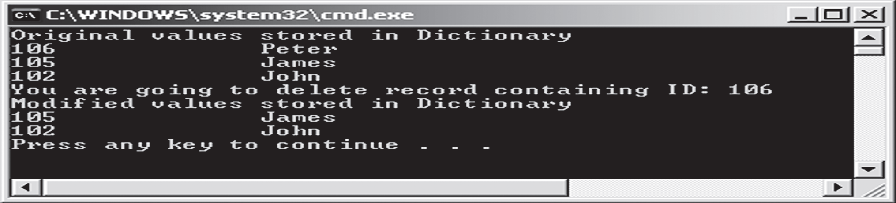
System.Collections Namespace 3-3
In the code:
The class Employee is inherited from the DictionaryBase class.
The DictionaryBase class is an abstract class. The details of the employees are inserted using the methods present in the DictionaryBase class.
The user-defined Add() method takes two parameters, namely id and name. These parameters are passed onto the Add() method of the Dictionary class.
The Dictionary class stores these values as a key/value pair.
The OnRemove() method of DictionaryBase is overridden. It takes a parameter specifying the key whose key/value pair is to be removed from the Dictionary class.
This method then prints a warning statement on the console before deleting the record from the Dictionary class.
The Dictionary.Remove() method is used to remove the key/value pair.
The GetEnumerator() method returns an IDictionaryEnumerator, which is used to traverse through the list.
The following figure displays the output of the example:
Employee objEmployee = new Employee();
objEmployee.Add(102, "John");
objEmployee.Add(105, "James");
objEmployee.Add(106, "Peter");
Console.WriteLine("Original values stored in
Dictionary");
objEmployee.GetDetails();
objEmployee.OnRemove(106);
Console.WriteLine("Modified values stored in
Dictionary");
objEmployee.GetDetails();
}
}

Slide 34
System.Collections.Generic Namespace
Consider an online application form used by students to register for an examination conducted by a university.
The application form can be used to apply for examination of any course offered by the university.
Similarly, in C#, generics allow you to define data structures that consist of functionalities which can be implemented for any data type.
Thus, generics allow you to reuse a code for different data types.
To create generics, you should use the built-in classes of the System.Collections.Generic namespace. These classes ensure type-checking.
To create generics, you should use the built-in classes of the System.Collections.Generic namespace.
These classes ensure type-safety, which is a feature of C# that ensures a value is treated as the type with which it is declared.
Example

Slide 35
Classes and Interfaces 1-5
The System.Collections.Generic namespace consists of classes and interfaces that define the different generic collections.
Classes:
The System.Collections.Generic namespace consists of classes that allow you to create type-safe collections.
The following table lists the commonly used classes in the System.Collections.Generic namespace:
Class | Description
List<T> | Provides a generic collection of items that can be dynamically resized
Stack<T> | Provides a generic collection that follows the LIFO principle, which means that the last item inserted in the collection will be removed first
Queue<T> | Provides a generic collection that follows the FIFO principle, which means that the first item inserted in the collection will be removed first
Dictionary<K, V> | Provides a generic collection of keys and values
SortedDictionary<K, V> | Provides a generic collection of sorted key and value pairs that consist of items sorted according to their key
LinkedList<T> | Implements the doubly linked list by storing elements in it

Slide 36
Classes and Interfaces 2-5
Interfaces and Structures
The System.Collections.Generic namespace consists of interfaces and structures that can be implemented to create type-safe collections.
The following table lists some of the commonly used ones:
Interface | Description
Icollection Interface | Defines methods to control the different generic collections
Ienumerable Interface | Is an interface that defines an enumerator to perform an iteration of a collection of a specific type
IComparer Interface | Is an interface that defines a method to compare two objects
IDictionary Interface | Represents a generic collection consisting of the key and value pairs
IEnumerator Interface | Supports simple iteration over elements of a generic collection
IList Interface | Represents a generic collection of items that can be accessed using the index position
Dictionary.Enumerator Structure | Lists the elements of a Dictionary
Dictionary.KeyCollection.Enumerator Structure | Lists the elements of a Dictionary.KeyCollection
Dictionary.ValueCollection.Enumerator Structure | Lists the elements of a Dictionary.ValueCollection
Key/ValuePair Structure | Defines a key/value pair

Slide 37
Classes and Interfaces 3-5
The following code demonstrates the use of the commonly used classes, interfaces, and structures of the System.Collection.Generic namespace:
using System;
using System.Collections;
using System.Collections.Generic;
class Student : IEnumerable
{
LinkedList<string> objList = new LinkedList<string>();
public void StudentDetails()
{
objList.AddFirst("James");
objList.AddFirst("John");
objList.AddFirst("Patrick");
objList.AddFirst("Peter");
objList.AddFirst("James");
Console.WriteLine("Number of elements stored in the list: "
+ objList.Count);
}
public void Display(string name)
{
LinkedListNode<string> objNode;
int count = 0;
for (objNode = objList.First; objNode != null; objNode =
objNode.Next)
{
if (objNode.Value.Equals(name))
{
count++;
}
}
Console.WriteLine("The value " + name + " appears " + count
+" times in the list");
Snippet

Slide 38
Classes and Interfaces 4-5
In the code:
The Student class implements the IEnumerable interface. A doubly-linked list of string type is created.
The StudentDetails() method is defined to insert values in the linked list.
The AddFirst() method of the LinkedList class is used to insert values in the linked list.
The Display() method accepts a single string argument that is used to search for a particular value. A LinkedListNode class reference of string type is created inside the Display() method.
This reference is used to traverse through the linked list.
Whenever a match is found for the string argument accepted in the Display() method, a counter is incremented.
This counter is then used to display the number of times the specified string has occurred in the linked list.
The GetEnumerator() method is implemented, which returns an IEnumerator.
The IEnumerator is used to traverse through the list and display all the values stored in the linked list.
}
public IEnumerator GetEnumerator()
{
return objList.GetEnumerator();
}
static void Main(string[] args)
{
Student objStudent = new Student();
objStudent.StudentDetails();
foreach (string str in objStudent)
{
Console.WriteLine(str);
}
objStudent.Display("James");
}
}

Slide 39
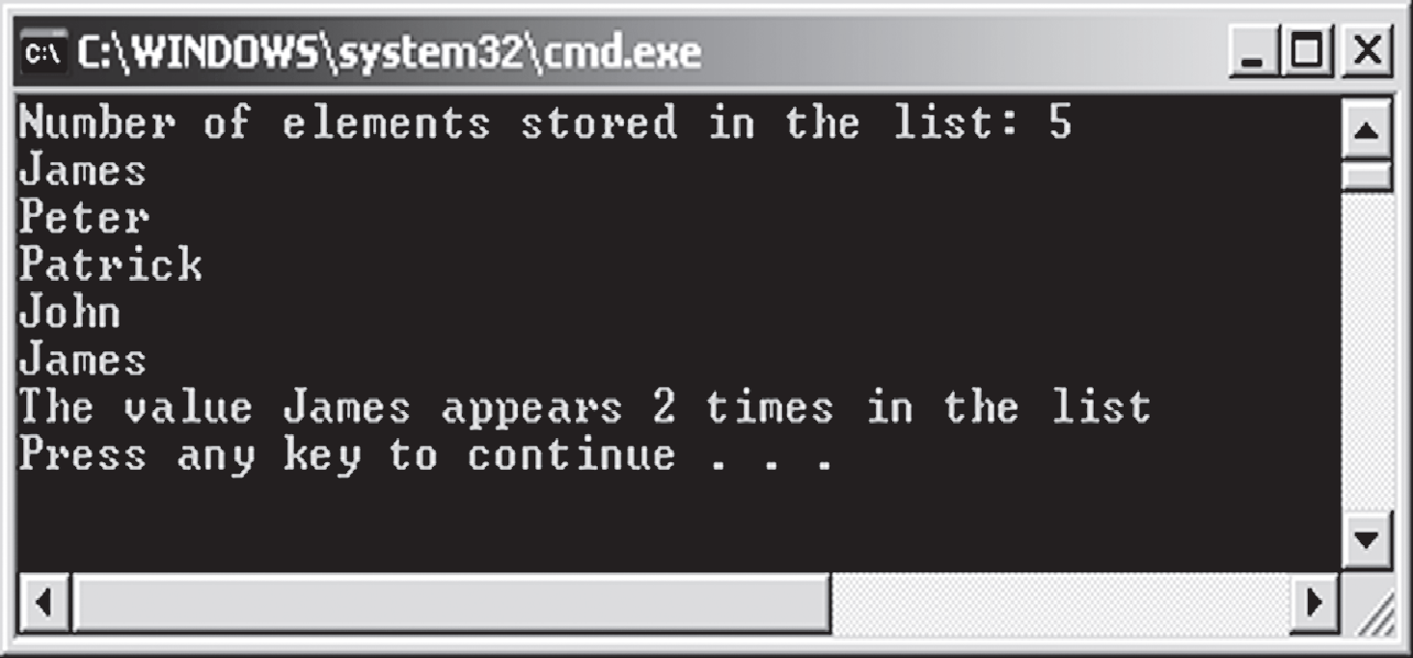
Classes and Interfaces 5-5
The following figure displays the System.Collection.Generic namespace example:

Slide 40
ArrayList Class 1-5
Following are the features of ArrayList class:
The ArrayList class is a variable-length array, that can dynamically increase or decrease in size. Unlike the Array class, this class can store elements of different data types.
However, the default capacity of an ArrayList class is 16. If the number of elements in the list reaches the specified capacity, the capacity of the list gets doubled automatically. It can accept null values and can also include duplicate elements.
The ArrayList class allows you to specify the size of the collection, during program execution and also allows you to define the capacity that specifies the number of elements an array list can contain.
The ArrayList class allows you to add, modify, and delete any type of element in the list even at run-time.
The elements in the ArrayList can be accessed by using the index position. While working with the ArrayList class, you need not bother about freeing up the memory.
The ArrayList class consists of different methods and properties that are used to add and manipulate the elements of the list.

Slide 41
ArrayList Class 2-5
Methods
The methods of the ArrayList class allow you to perform actions such as adding, removing, and copying elements in the list.
The following table displays the commonly used methods of the ArrayList class:
Properties
The properties of the ArrayList class allow you to count or retrieve the elements in the list. The following table displays the commonly used properties of the ArrayList class:
Method | Description
Add | Adds an element at the end of the list
Remove | Removes the specified element that has occurred for the first time in the list
RemoveAt | Removes the element present at the specified index position in the list
Insert | Inserts an element into the list at the specified index position
Contains | Determines the existence of a particular element in the list
IndexOf | Returns the index position of an element occurring for the first time in the list
Reverse | Reverses the values stored in the ArrayList
Sort | Rearranges the elements in an ascending order
Property | Description
Capacity | Specifies the number of elements the list can contain
Count | Determines the number of elements present in the list
Item | Retrieves or sets value at the specified position

Slide 42
ArrayList Class 3-5
The following code demonstrates the use of the methods and properties of the ArrayList class:
In the code:
The Add() method inserts values into the instance of the class at different index positions.
The RemoveAt() method removes the value James from the index position 2 and the Insert() method inserts the value Williams at the index position 2.
The WriteLine() method is used to display the number of elements the list can contain and the number of elements present in the list using the Capacity and Count properties respectively.
Capacity: 4
Count: 3
Elements of the ArrayList
John
James
Williams
using System;
using System.Collections;
class ArrayCollection
{
static void Main(string[] args)
{
ArrayList objArray = new ArrayList();
objArray.Add("John");
objArray.Add("James");
objArray.Add("Peter");
objArray.RemoveAt(2);
objArray.Insert(2, "Williams");
Console.WriteLine("Capacity: " + objArray.Capacity);
Console.WriteLine("Count: " + objArray.Count);
Console.WriteLine();
Console.WriteLine("Elements of the ArrayList");
foreach (string str in objArray)
{
Console.WriteLine(str);
}
}
}
Snippet
Output

Slide 43
ArrayList Class 4-5
using System;
using System.Collections;
class Customers
{
static void Main(string[] args)
{
ArrayList objCustomers = new ArrayList();
objCustomers.Add("Nicole Anderson");
objCustomers.Add("Ashley Thomas");
objCustomers.Add("Garry White");
Console.WriteLine("Fixed Size : " +
objCustomers.IsFixedSize);
Console.WriteLine("Count : " + objCustomers.Count);
Console.WriteLine("List of customers:");
foreach (string names in objCustomers)
{
Console.WriteLine("{0}",names);
}
objCustomers.Sort();
Console.WriteLine("\nList of customers after
sorting:");
foreach (string names in objCustomers)
{
Console.WriteLine("{0}", names);
}
objCustomers.Reverse();
Console.WriteLine("\nList of customers after
reversing:");
foreach (string names in objCustomers)
{

Slide 44
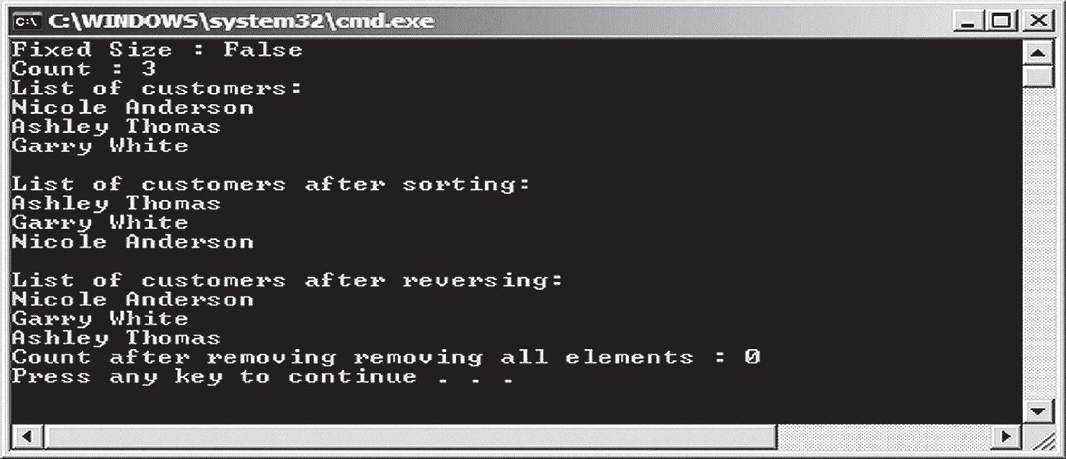
ArrayList Class 5-5
Console.WriteLine("{0}", names);
}
objCustomers.Clear();
Console.WriteLine("Count after removing all elements
: " + objCustomers.Count);
}
}
In the code:
The Add() method inserts value at the end of the ArrayList. The values inserted in the array are displayed in the same order before the Sort() method is used.
The Sort() method then displays the values in the sorted order. The FixedSize() property checks whether the array is of a fixed size.
When the Reverse() method is called, it displays the values in the reverse order.
The Clear() method deletes all the values from the ArrayList class.
The following figure displays the use of methods of the ArrayList class:

Slide 45
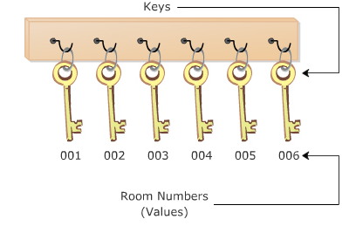
Hashtable Class 1-7
Consider the reception area of a hotel where you find the keyholder storing a bunch of keys.
Each key in the keyholder uniquely identifies a room and thus, each room is uniquely identified by its key.
The following figure demonstrates a real-world example of unique keys:
Similar to the keyholder, the Hashtable class in C# allows you to create collections in the form of keys and values.
It generates a hashtable which associates keys with their corresponding values.
The Hashtable class uses the hashtable to retrieve values associated with their unique key.

Slide 46
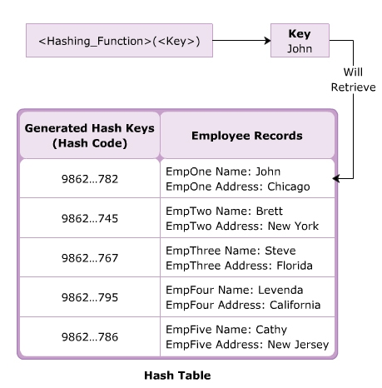
Hashtable Class 2-7
The hashtable generated by the Hashtable class uses the hashing technique to retrieve the corresponding value of a key.
Hashing is a process of generating the hash code for the key and the code is used to identify the corresponding value of the key.
The Hashtable object takes the key to search the value, performs a hashing function and generates a hash code for that key.
When you search for a particular value using the key, the hash code is used as an index to locate the desired record.
For example, a student name can be used as a key to retrieve the student id and the corresponding residential address. The following figure represents the Hashtable:

Slide 47
Hashtable Class 3-7
The Hashtable class consists of different methods and properties that are used to add and manipulate the data within the hashtable.
The methods of the Hashtable class allow you to perform certain actions on the data in the hashtable.
The following table displays the commonly used methods of the Hashtable class:
Properties
The properties of the Hashtable class allow you to access and modify the data in the hashtable.
The following figure displays the commonly used properties of the Hashtable class:
Method | Description
Add | Adds an element with the specified key and value
Remove | Removes the element having the specified key
CopyTo | Copies elements of the hashtable to an array at the specified index
ContainsKey | Checks whether the hashtable contains the specified key
ContainsValue | Checks whether the hashtable contains the specified value
GetEnumerator | Returns an IDictionaryEnumerator that traverses through the Hashtable
Property | Description
Count | Specifies the number of key and value pairs in the hashtable
Item | Specifies the value, adds a new value or modifies the existing value for the specified key
Keys | Provides an ICollection consisting of keys in the hashtable
Values | Provides an ICollection consisting of values in the hashtable
IsReadOnly | Checks whether the Hashtable is read-only

Slide 48
Hashtable Class 4-7
The following code demonstrates the use of the methods and properties of the Hashtable class:
Snippet
using System;
using System.Collections;
class HashCollection
{
static void Main(string[] args)
{
Hashtable objTable = new Hashtable();
objTable.Add(001, "John");
objTable.Add(002, "Peter");
objTable.Add(003, "James");
objTable.Add(004, "Joe");
Console.WriteLine("Number of elements in the hash table: " +
objTable.Count);
ICollection objCollection = objTable.Keys;
Console.WriteLine("Original values stored in hashtable are:
");
foreach (int i in objCollection)
{
Console.WriteLine (i + " : " + objTable[i]);
}
if (objTable.ContainsKey(002))
{
objTable[002] = "Patrick";
}
Console.WriteLine("Values stored in the hashtable after
removing values");
foreach (int i in objCollection)
{
Console.WriteLine(i + " : " + objTable[i]);
}
}
}

Slide 49
Hashtable Class 5-7
Number of elements in the hashtable: 4
Original values stored in hashtable are:
4 : Joe
3 : James
2 : Peter
1 : John
Values stored in the hashtable after removing values
4 : Joe
3 : James
2 : Patrick
1 : John
In the Code:
The Add() method inserts the keys and their corresponding values into the instance. The Count property displays the number of elements in the hashtable.
The Keys property provides the number of keys to the instance of the ICollection interface.
The ContainsKey() method checks whether the hashtable contains the specified key. If the hashtable contains the specified key, 002, the default Item property that is invoked using the square bracket notation ([]) replaces the value Peter to the value Patrick.
This output is in the descending order of the key. However, the output may not always be displayed in this order.
It could be either in ascending or random orders depending on the hash code.
Output

Slide 50
Hashtable Class 6-7
The Code Snippet
demonstrates the
use of methods
and properties of
the Hashtable
class.
using System;
using System;
using System.Collections;
class Authors
{
static void Main(string[] args)
{
Hashtable objAuthors = new Hashtable();
objAuthors.Add("AU01","John");
objAuthors.Add("AU04", "Mary");
objAuthors.Add("AU09", "William");
objAuthors.Add("AU11", "Rodrick");
Console.WriteLine("Read-only : " +
objAuthors.IsReadOnly);
Console.WriteLine("Count : " + objAuthors.Count);
IDictionaryEnumerator objCollection =
objAuthors.GetEnumerator();
Console.WriteLine("List of authors:\n");
Console.WriteLine("Author ID \t Name");
while(objCollection.MoveNext())
{
Console.WriteLine(objCollection.Key + "\t\t " +
objCollection.Value);
}
if(objAuthors.Contains("AU01"))
{
Console.WriteLine("\nList contains author with id
AU01");
}
else
{
Console.WriteLine("\nList does not contain author
with id AU01");
}
}
}
Snippet

Slide 51
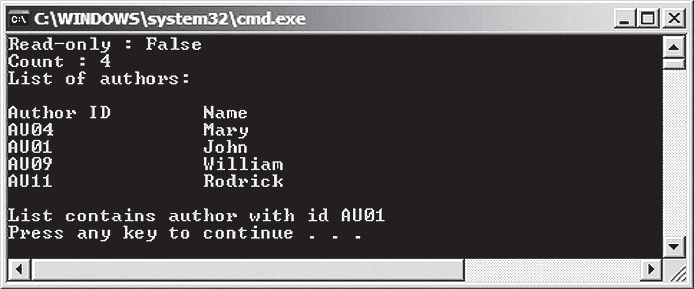
Hashtable Class 7-7
In the code:
The Add() method inserts values in the Hashtable.
The IsReadOnly() method checks whether the values in the array can be modified or not.
The Contains() method checks whether the value AU01 is present in the list.
The following figure displays the Hashtable example:

Slide 52
SortedList Class 1-6
The SortedList class represents a collection of key and value pairs where elements are sorted according to the key.
By default, the SortedList class sorts the elements in ascending order, however, this can be changed if an IComparable object is passed to the constructor of the SortedList class.
These elements are either accessed using the corresponding keys or the index numbers.
If you access elements using their keys, the SortedList class behaves like a hashtable, whereas if you access elements based on their index number, it behaves like an array.
The SortedList class consists of different methods and properties that are used to add and manipulate the data in the sorted list.
Methods
The methods of the SortedList class allow you to perform certain actions on the data in the sorted list.

Slide 53
SortedList Class 2-6
The following table displays the commonly used methods of the SortedList class:
Properties
The properties of the SortedList class allow you to access and modify the data in the sorted list.
Method | Description
Add | Adds an element to the sorted list with the specified key and value
Remove | Removes the element having the specified key from the sorted list
GetKey | Returns the key at the specified index position
GetByIndex | Returns the value at the specified index position
ContainsKey | Checks whether the instance of the SortedList class contains the specified key
ContainsValue | Checks whether the instance of the SortedList class contains the specified value
RemoveAt | Deletes the element at the specified index
Property | Description
Capacity | Specifies the number of elements the sorted list can contain
Count | Specifies the number of elements in the sorted list
Item | Returns the value, adds a new value or modifies the existing value for the specified key
Keys | Returns the keys in the sorted list
Values | Returns the values in the sorted list

Slide 54
SortedList Class 3-6
The following code demonstrates the use of methods and properties of the SortedList class:
Snippet
using System;
using System.Collections;
class SortedCollection
{
static void Main(string[] args)
{
SortedList objSortList = new SortedList();
objSortList.Add("John", "Administration");
objSortList.Add("Jack", "Human Resources");
objSortList.Add("Peter", "Finance");
objSortList.Add("Joel", "Marketing");
Console.WriteLine("Original values stored in the
sorted list");
Console.WriteLine("Key \t\t Values");
for (int i=0; i<objSortList.Count; i++)
{
Console.WriteLine(objSortList.GetKey(i) + " \t\t " +
objSortList.GetByIndex(i));
}
if (!objSortList.ContainsKey("Jerry"))
{
objSortList.Add("Jerry", "Construction");
}
objSortList["Peter"] = "Engineering";
objSortList["Jerry"] = "Information Technology";
Console.WriteLine();
Console.WriteLine("Updated values stored in hashtable");
Console.WriteLine("Key \t\t Values");
for (int i = 0; i < objSortList.Count; i++)
{
Console.WriteLine(objSortList.GetKey(i) + " \t\t " +
objSortList.GetByIndex(i));
}
}
}

Slide 55
SortedList Class 4-6
In the code:
The Add() method inserts keys and their corresponding values into the instance and the Count property counts the number of elements in the sorted list.
The GetKey() method returns the keys in the sorted order from the sorted list while the GetByIndex() method returns the values at the specified index position.
If the sorted list does not contain the specified key, Jerry, then the Add() method adds the key, Jerry with its corresponding value.
The default Item property that is invoked using the square bracket notation ([]) replaces the values associated with the specified keys, Peter and Jerry.
Original values stored in the sorted list
Key Values
Jack Human Resources
Joel Marketing
John Administration
Peter Finance
Updated values stored in hashtable
Key Values
Jack Human Resources
Jerry Information Technology
Joel Marketing
John Administration
Peter Engineering
Output

Slide 56
SortedList Class 5-6
The following code demonstrates the use of methods in the SortedList class:
using System;
using System.Collections;
class Countries
{
static void Main(string[] args)
{
SortedList objCountries = new SortedList();
objCountries.Add("UK", "United Kingdom");
objCountries.Add("GER", "Germany");
objCountries.Add("USA", "United States of America");
objCountries.Add("AUS", "Australia");
Console.WriteLine("Read-only : " +
objCountries.IsReadOnly);
Console.WriteLine("Count : " + objCountries.Count);
Console.WriteLine("List of countries:\n");
Console.WriteLine("Country Code \t Name");
for ( int i = 0; i < objCountries.Count; i++ )
{
Console.WriteLine(objCountries.GetKey(i) + "\t\t
" + objCountries.GetByIndex(i));
}
objCountries.RemoveAt(1);
Console.WriteLine("\nList of countries after removing
element at index 1:\n");
Console.WriteLine("Country Code \t Name");
for (int i = 0; i < objCountries.Count; i++)
{
Console.WriteLine(objCountries.GetKey(i) + "\t\t
" + objCountries.GetByIndex(i));
}
}
}
Snippet

Slide 57
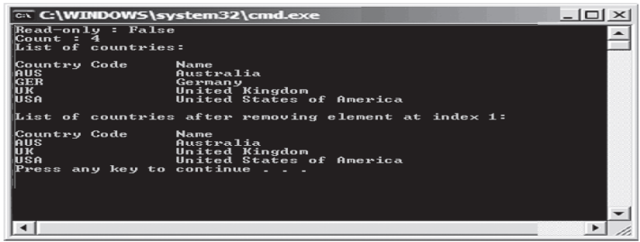
SortedList Class 6-6
The following figure displays the SortedList class example:
In the code:
The Add() method inserts values in the list.
The IsReadOnly() method checks whether the values in the list can be modified or not. The GetByIndex() method returns the value at the specified index.
The RemoveAt() method removes the value at the specified index.

Slide 58
DictionaryGeneric Class 1-6
The System.Collections.Generic namespace contains a vast number of generic collections.
One of the most commonly used among these is the Dictionary generic class that consists of a generic collection of elements organized in key and value pairs and maps the keys to their corresponding values.
Unlike other collections in the System.Collections namespace, it is used to create a collection of a single data type at a time.
Every element that you add to the dictionary consists of a value, which is associated with its key and can retrieve a value from the dictionary by using its key.
The following syntax declares a Dictionary generic class:
where,
TKey: Is the type parameter of the keys to be stored in the instance of the Dictionary class.
TValue: Is the type parameter of the values to be stored in the instance of the Dictionary class.
Syntax
Dictionary<TKey, TValue>

Slide 59
DictionaryGeneric Class 2-6
The Dictionary generic class consists of different methods and properties that are used to add and manipulate elements in a collection.
Methods
The methods of the Dictionary generic class allow you to perform certain actions on the data in the collection.
The following table displays the commonly used methods of the Dictionary generic class:
Properties
The properties of the Dictionary generic class allow you to modify the data in the collection.
The following table displays the commonly used properties of the Dictionary generic class:
Method | Description
Add | Adds the specified key and value in the collection
Remove | Removes the value associated with the specified key
ContainsKey | Checks whether the collection contains the specified key
ContainsValue | Checks whether the collection contains the specified value
GetEnumerator | Returns an enumerator that traverses through the Dictionary
GetType | Retrieves the Type of the current instance
Property | Description
Count | Determines the number of key and value pairs in the collection
Item | Returns the value, adds a new value or modifies the existing value for the specified key
Keys | Returns the collection containing the keys
Values | Returns the collection containing the values

Slide 60
DictionaryGeneric Class 3-6
The following code demonstrates the use of the methods and properties of the Dictionary class:
Snippet
using System;
using System.Collections;
class DictionaryCollection{
static void Main(string[] args) {
Dictionary<int, string> objDictionary = new Dictionary<int,
string>();
objDictionary.Add(25, "Hard Disk");
objDictionary.Add(30, "Processor");
objDictionary.Add(15, "MotherBoard");
objDictionary.Add(65, "Memory");
ICollection objCollect = objDictionary.Keys;
Console.WriteLine("Original values stored in the collection");
Console.WriteLine("Keys \t Values");
Console.WriteLine("----------------");
foreach (int i in objCollect){
Console.WriteLine(i + " \t " + objDictionary[i]);
}
objDictionary.Remove(65);
Console.WriteLine();
if (objDictionary.ContainsValue("Memory")) {
Console.WriteLine("Value Memory could not be deleted");
}
else {
Console.WriteLine("Value Memory deleted successfully");
}
Console.WriteLine();
Console.WriteLine("Values stored after removing element");
Console.WriteLine("Keys \t Values");
Console.WriteLine("----------------");
foreach (int i in objCollect) {
Console.WriteLine(i + " \t " + objDictionary[i]);
}
}
}

Slide 61
DictionaryGeneric Class 4-6
In the code:
The Dictionary class is instantiated by specifying the int and string data types as the two parameters.
The int data type indicates the keys and the string data type indicates values.
The Add() method inserts keys and values into the instance of the Dictionary class.
The Keys property provides the number of keys to the instance of the ICollection interface.
The ICollection interface defines the size and synchronization methods to manipulate the specified generic collection.
The Remove() method removes the value Memory by specifying the key associated with it, which is 65.
The ContainsValue() method checks whether the value Memory is present in the collection and displays the appropriate message.
Original values stored in the collection
Keys Values
----------------
25 Hard Disk
30 Processor
15 MotherBoard
65 Memory
Value Memory deleted successfully
Values stored after removing element
Keys Values
----------------
25 Hard Disk
30 Processor
15 MotherBoard
Output

Slide 62
DictionaryGeneric Class 5-6
The following code demonstrates the use of methods in Dictionary generic class:
Snippet
using System;
using System.Collections;
using System.Collections.Generic;
class Car
{
static void Main(string[] args)
{
Dictionary<int, string> objDictionary = new
Dictionary<int,string>();
objDictionary.Add(201, "Gear Box");
objDictionary.Add(220, "Oil Filter");
objDictionary.Add(330, "Engine");
objDictionary.Add(305, "Radiator");
objDictionary.Add(303, "Steering");
Console.WriteLine("Dictionary class contains values
of type");
Console.WriteLine(objDictionary.GetType());
Console.WriteLine("Keys \t\t Values");
Console.WriteLine("__________________________");
IDictionaryEnumerator objDictionayEnumerator =
objDictionary.GetEnumerator();
while (objDictionayEnumerator.MoveNext ())
{
Console.WriteLine(objDictionayEnumerator.Key.ToString()
+ "\t\t"+ objDictionayEnumerator.Value);
}
}
}

Slide 63
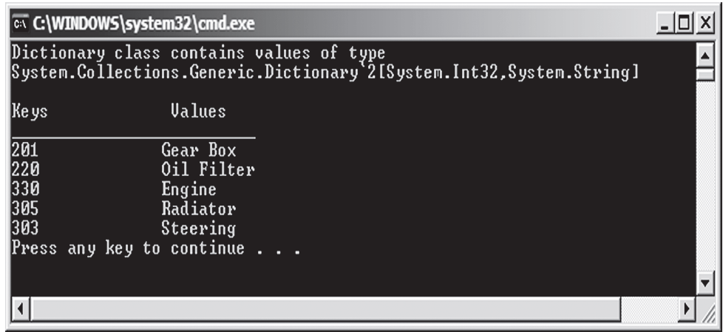
DictionaryGeneric Class 6-6
In the code:
The Add() method inserts values into the list.
The GetType() method returns the type of the object.
The following figure displays the use of Dictionary generic class:

Slide 64
Collection Initializers 1-2
Collection initializers allow adding elements to the collection classes of the System.Collections and System.Collections.Generic namespaces that implements the Ienumerable interface using element initializers.
The element initializers can be a simple value, an expression, or an object initializer.
When a programmer uses collection initializer, the programmer is not required to provide multiple Add() methods to add elements to the collection, making the code concise. It is the responsibility of the compiler to provide the Add()methods when the program is compiled.
The following code uses a collection initializer to initialize an ArrayList with integers:
1
2
18
4
5
Snippet
using System;
using System.Collections;
class Car
{
static void Main (string [] args)
{
ArrayList nums=new ArrayList{1,2,3*6,4,5};
foreach (int num in nums)
{
Console.WriteLine("{0}", num);
}
}
}
Output

Slide 65
Collection Initializers 2-2
In the code:
The Main() method uses collection initializer to create an ArrayList object initialized with integer values and expressions that evaluates to integer values.
As collection often contains objects, collection initializers accept object initializers to initialize a collection.
The following code shows a collection initializer that initializes a generic Dictionary object with an integer keys and Employee objects:
In the code:
The Employee class consists of two public properties: Name and Designation.
The Main() method creates a Dictionary<int, Employee> object and encloses the collection initializers within a pair of braces.
For each element, added to the collection, the innermost pair of braces encloses the object initializer of the Employee class.
Snippet
using System;
using System.Collections;
using System.Collections.Generic;
class Employee{
public String Name { get; set; }
public String Designation { get; set; }
}
class CollectionInitializerDemo{
static void Main(string[] args)
{
Dictionary<int, Employee> dict = new Dictionary<int,
Employee>(){
{ 1, new Employee {Name="Andy Parker",
Designation="Sales Person"}}, { 2, new Employee {Name="Patrick Elvis",
Designation="Marketing Manager"}}
};
}
}

Slide 66
Summary
A delegate in C# is used to refer to a method in a safe manner.
An event is a data member that enables an object to provide notifications to other objects about a particular action.
The System.Collections.Generic namespace consists of generic collections that allow reusability of code and provide better type-safety.
The ArrayList class allows you to increase or decrease the size of the collection during program executionHashtable class.
The Hashtable class stores elements as key and value pairs where the data is organized based on the hash code. Each value in the hashtable is uniquely identified by its key.
The SortedList class allows you to store elements as key and value pairs where the data is sorted based on the key.
The Dictionary generic class represents a collection of elements organized in key and value pairs.

Slide 67

THANKS FOR WATCHING !

